Slide 1
Testing and Commissioning
Integrated System Turnover (ISTO) Process
March 2023
LP03 Medical Plaza Bldg., 100 Amorsolo Street Legaspi Village Makati City Philippines 1229
www.forsspacglobal.com

Slide 2
Training Agenda
- Training Objective
- Integrated System Turnover Overview
- ISTO Numbering System
- Method Statement Documentation
- O&M Manual Documentation
- Monitoring and Scheduling
- T&C Management Report Overview
- LEED Commissioning Report Overview
- BERDE Commissioning Report Overview
- Project S-Curves
- T&C Management Report Overview

Slide 3
Training Objective
As core member of the team – to lead the team towards achieving projects GOALS.
- Finish the project within the scheduled timetable
- Finish the project within the scheduled budget
- Finish the project within the level of Quality
- Complete the project according to client requirement
- Handover the project without slip-up

Slide 4
ISTO PROCESS
ISTO Process is the testing and commissioning documentation process to meet the requirements of the project with a certain T&C scope.
ISTO is a proprietary methodology of Forsspac for scheduling, monitoring, witnessing and turnover of MEPF system and services. This method aims to ensure that T&C process is done and delivered properly
ISTO Numbering system
Operation and Maintenance Manual
Method Statements
O&M Training and Seminars
Test Packages

Slide 5
ISTO NUMBERING SYSTEM
ISTO Numbering system
Is a method of identifying a certain equipment given in a project to be tested and commissioned.
The 1st step to start the project documentation
System Package
Equipment Tagging
ISTO number
Description
Location

Slide 6
ISTO Handover Packages summary
Notes:
.

Slide 7
ISTO PROCESS
Testing Procedures (Method Statement) Documentation
Must have:
Is an outline how the testing and commissioning team execute the works
Applicable Codes and Standards
Objective
Criteria
Performance Procedure of Equipment
Testing Instruments
Testing Forms

Slide 8
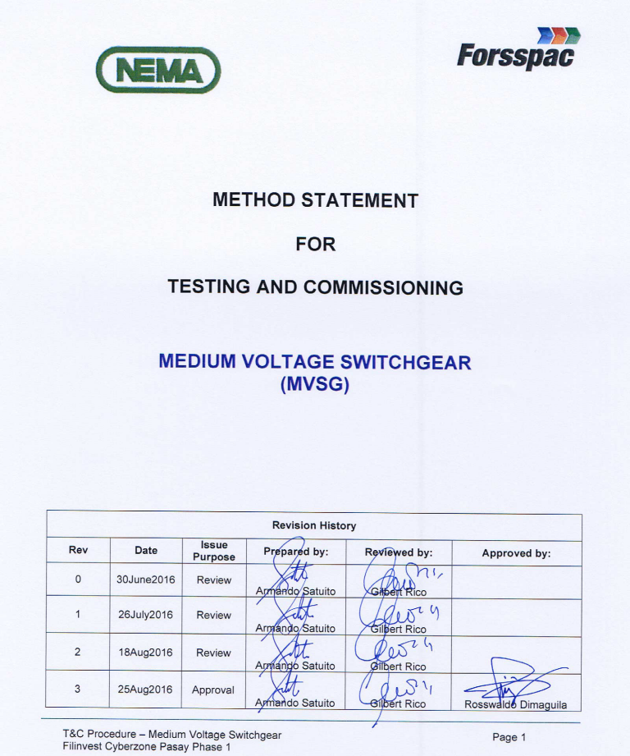
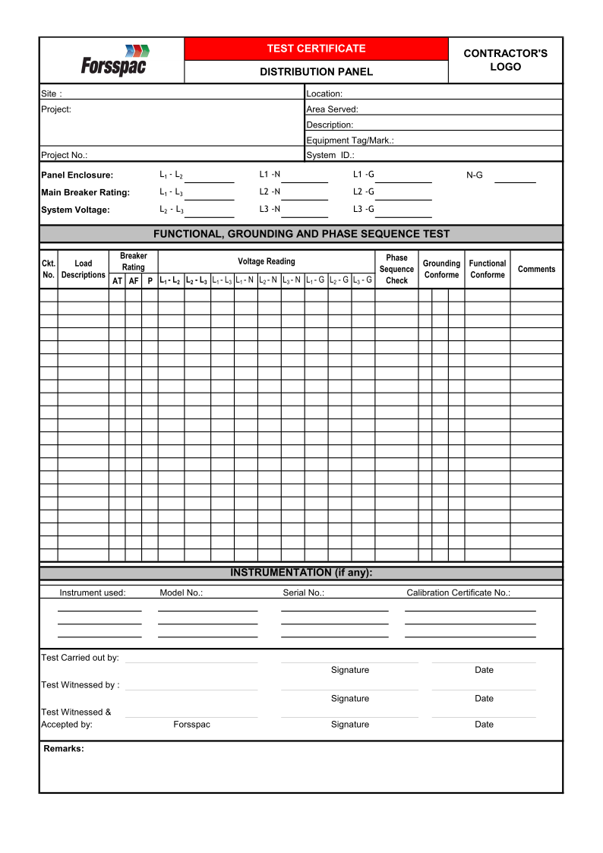
Testing and Commissioning Method Statement
T&C Test Forms
Testing Equipment
ISO related

Slide 9
ISTO PROCESS
Commissioning Test Results (test Packs)
Testing and Commissioning Test result
Is the end result in the T&C witnessing scope.
Testing and Commissioning punchlists
Approved Equipment Submittals
Construction Test records
Instrument Calibration Certificates
Part Plan / As-Built Drawing

Slide 10
ISTO Handover
Test Packages
Forsspac-ISTO-No.: |  |  | PP3-01
Packaged ID No.: |  |  | PL - 01
Location: |  |  | Basement
Description: |  |  | Transfer Pump
Equipment Mark: |  |  | TP-1A
COMMISSIONING DOCUMENTATION REQUIRED
Item | Verified | Comments
1. T&C Test Records |  | Attached to this Test Pack
2. Punchlists |  | Attached to this Test Pack
3. Construction Inspection Test Records |  | Date Completed:
4. Approved Equipment Submittals |  | Date Completed
5. Instrument Calibration Certificates |  | Refer to Instrument Calibration Report
6. Approved As-Built Plan / Drawings |  | Attached to this Test Pack
ISO related

Slide 11
ISTO PROCESS
Operation and Maintenance Manual Documentation
Section A
Section B
O&M Manual contains the information required for the operation, maintenance and a commissioning results of a system in a building.
Is set of documents that the building operator must have upon handover of the building
Section C
Section D
Section E
Section F
Section G
Section H

Slide 12
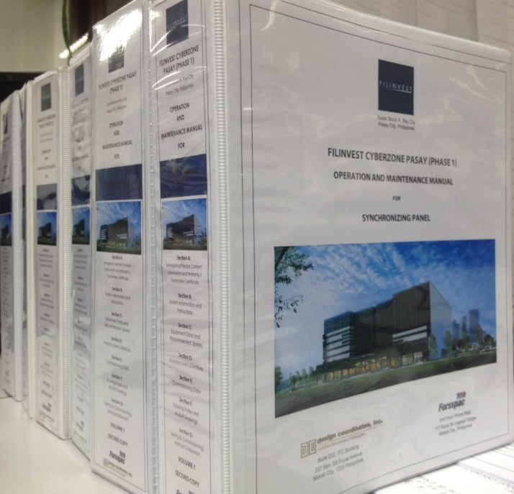
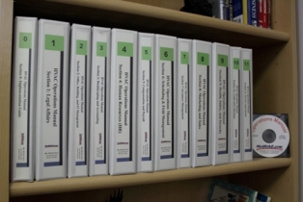
Section A
Emergency / Vendors Contact Information and Warranties/ Guarantees Certificates
O&M Manual Compilation
Section B
System Instruction and Information
Section C
Equipment Data and Recommended Spares
Section D
Manufacturer's Literature
Section E
Testing and Commissioning Method Statement
Section F
Commissioning Data
Section G
Drawing Index and As-Built Drawings
Section H
O&M Training and Seminar Requirements

Slide 13
ISTO PROCESS
Monitoring and Scheduling
Monitoring and Scheduling is a part of the proprietary of Forsspac software system controls. ISTO thereby allows to track the progress of all aspects of the project and to ensure that we do not miss a single equipment involved in the project and to ensure that progress is done in specific scheduled timeline.
O&M Manual monitoring report
T&C Method Statement monitoring submittal
T&C witnessing monitoring report
Punchlists monitoring report

Slide 14
T&C Accomplishment Monitoring

Slide 15
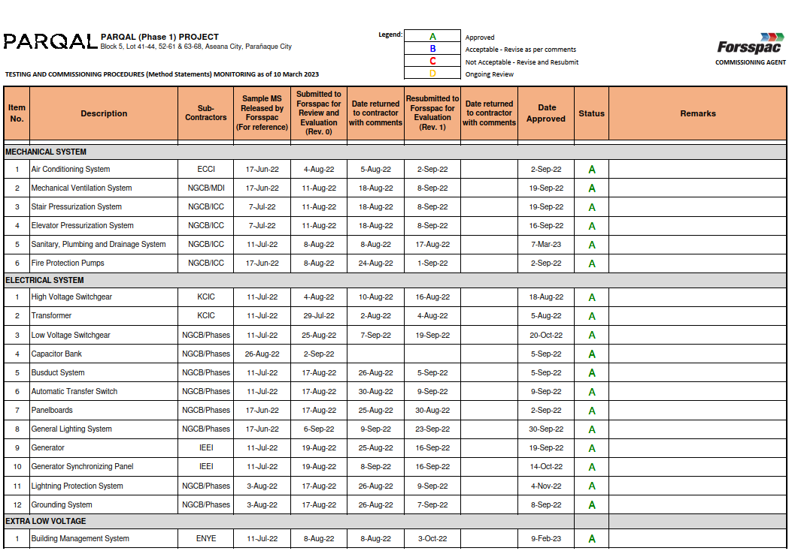
Method Statement Monitoring

Slide 16
O&M Manual Monitoring

Slide 17
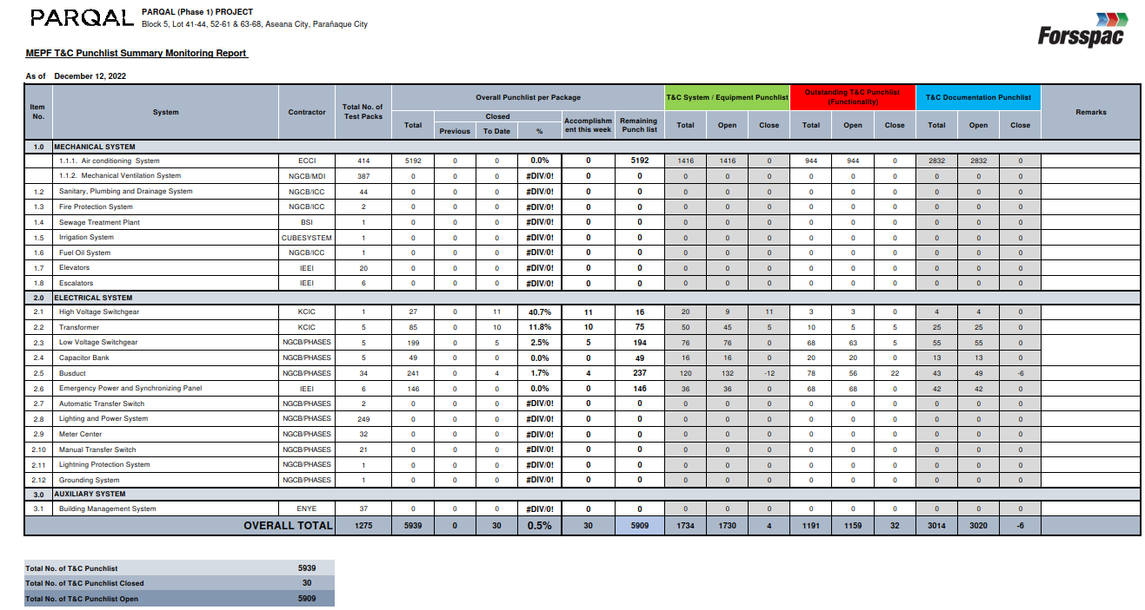
Punchlist Monitoring

Slide 18
Project Reports

Slide 19
PROJECT REPORTS
T&C Management
Report
Specific content is the ISTO process
BERDE report
LEED report
Specific content are the LEED documentation requirement including ISTO process
Specific content are the BERDE documentation requirements including ISTO process

Slide 20
T&C Management Report Overview
Executive Summary
II. Introduction
III. Testing and Commissioning
A. Integrated Systems Turnover (ISTO) Methodology
B. Test Procedures/Method Statement
C. Handover Packages
C.1 Completed / Incomplete System
D. Fire and Life Safety System
E. Operation and Maintenance Manual
F. Operation and Maintenance User’s Training
IV. Appendices
A. Summary of Handover Packages
Testing and Commissioning Procedure Monitoring Submittal
Testing and Commissioning Witnessing Summary Report
Punchlists Summary Report
E. Operation and Maintenance Manual Monitoring Report
F. Operation and Maintenance Manual Training Record

Slide 21
LEED Commissioning Report Overview
I. Executive Summary
A. Project Description
B. Commissioning Goals
C. Commissioning Scope
D. Systems to be Commissioned
E. Significant Issues Found During Commissioning
F. Future Commissioning Recommendation
II. Commissioning Requirements
A. Commissioning Plan
B. Submittal Review Process
C. Test Procedures/Method Statement
D. Operations and Maintenance Documentation
E. Systems Manual Documentation
F. Integrated Systems Turnover (ISTO) Methodology
G. Users Training
III. 50% Design Review Analysis and Results
A. Owner’s Project Requirements
B. Basis of Design
C. Commissioning Specifications
IV. Deficiency Resolution
A. Pre-Design Phase
B. Design Phase
C. Construction Phase
D. Occupancy and Acceptance Phase
V. Systems Performance Test Results and Evaluation
A. Pre-Functional Testing
B. Testing, Adjusting and Balancing
C. Functional Testing
VI. Post Occupancy Agenda
VII. Appendices
A. Commissioning Plan
B. Submittal Review Results
C. Test Procedure Monitoring Submittal
D. Operation and Maintenance Manual Monitoring Submittal
E. Sample ISTO Test Packages
F. List of ISTO Test Packages
G. User's Training Summary Report
H. Design Review Results
I. Commissioning Specification
J. Punchlist Monitoring Status
K. ISTO Test Package Completion
Status Report

Slide 22
BERDE Commissioning Report Overview
I. Executive Summary
A. Project Description
B. Commissioning Goals
C. Commissioning Scope
D. Systems to be Commissioned
E. Significant Issues Found During Commissioning
F. Future Commissioning Recommendation
II. Commissioning Requirements
A. Review of Design Document
B. Commissioning Plan
C. Test Procedures/Method Statement
D. Operations and Maintenance Documentation
E. Integrated Systems Turnover (ISTO) Methodology
F. Users Training
III. Deficiency Resolution
A. Design Phase
B. Construction Phase
C. Acceptance Phase
IV. Systems Performance Test Results and Evaluation
A. Pre-Functional Testing
B. Testing, Adjusting and Balancing
C. Functional Testing
V. Appendices
A. Commissioning Plan
B. Test Procedure Monitoring Submittal
C. Operation and Maintenance Manual Monitoring Submittal
D. Sample ISTO Test Packages
E. List of ISTO Test Packages
F. User's Training Summary Report
G. Design Review Results
H. Punchlist Monitoring Status
I. ISTO Test Package Completion Status Report

Slide 23
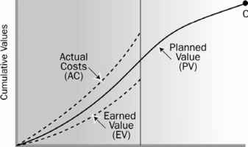
Project S-curves

Slide 24
Project S-curves (Manhours versus accomplishment)
An s-curve is a graphical representation of the cumulative work effort, or a subset of the work effort.
It is also a project management tool that tracks progress over time. It allows a quick visual to determine the project status from planned versus actual.
Planning
Monitoring
Execution
2nd
3rd
1st

Slide 25
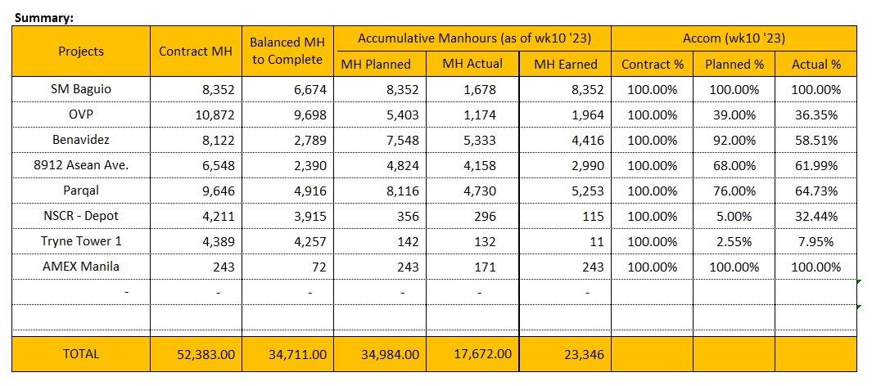
Projects Accomplishment Summary

Slide 26
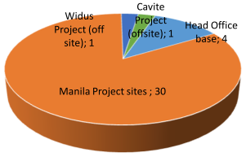
Project S-curves (Manhours and Manpower Efficiency)

Slide 27
Project S-curves (Accomplishment Efficiency)

