Slide 1
TESTING, ADJUSTING & BALANCING TRAINING PRESENTATION
April 2023
LP03 Medical Plaza Bldg., 100 Amorsolo Street Legaspi Village Makati City Philippines 1229
www.forsspacglobal.com

Slide 2
Presentation outline
INTRODUCTION
APPLICALBE DOCUMENTS
PREREQUISITES
PROCEDURES
INTENDED USE
REFERENCES
BASIC PRINCIPLES
PREPARATION
AIR SYSTEM
TESTING, ADJUSTING and BALANCING STEP BY STEP PROCEDURE
PROCEDURES FOR MEASURING TOTAL AIRFLOW BY PITOT TUBE
MAIN BALANCING
BRANCH BALANCING
TERMINAL BALANCING
TEST FORMS
FINAL TEST
ACCEPTANCE CRITEREA
PERFORMANCE TEST
FINAL TEST, INSPECTION AND ACCEPTANCE
INSTRUMENT TO BE USED
Notes:
Speech Notes - Slide 1
1. [Title 15] Title 15 Clip
Testing and Commissioning Management
2. [Slide] tv
testing and commissioning Management Services by Forspac ensure that the final building at handover follows the design intent resulting in a safe building that are pleasant to be in and are as energy efficient as possible.

Slide 3
INTRODUCTION
Test procedures (in compliance with the project Specification) shall be performed in accordance with the NATIONAL ENVIRONMENTAL BALANCING BUREAU (NEBB) publication “Procedural Standards for Testing, Adjusting and Balancing of Environmental Systems”.

Slide 4
APPLICABLE DOCUMENTS
Documentation required prior to on-site testing consist of the following:
1. Technical specifications
2. Record drawings (or as-built if applicable)
3. Approved submittal data and other documents as may be required.
Founded in 1988 in Hong Kong
Founded in 1988 in Hong Kong
Based in Manila since 1996
Based in Manila since 1996

Slide 5
PREREQUISITES
Prior to the proceeding with the testing activities, the following prerequisites must be completed.
1. Procedures submitted and Approved.
2. Installation are complete.
3. Construction related tests complete (leakage test, etc.)
4. Quality Control inspection is completed.
5. Installation Verification checks successfully complete.
6. Applicable documents prepared and available.

Slide 6
PROCEDURES
These procedures cover the placing of the various HVAC systems into operation, testing, adjusting and balancing flow, and upon completion of the proceeding tests, conducting operational test of the various systems to determine the actual system performances. All other test and reporting as required to confirm that the installation meets the specified conditions shall also be performed. Specified procedures for each activity are provided hereunder.

Slide 7
INTENDED USE
Test to verify proper and safe operation, determine actual point of performance, evaluate qualitative and quantitative performance of equipment, systems and controls at design, average and low loads using actual or simulated loads.
Adjust and regulate equipment and systems so as to meet specified performance requirements and to achieve specified interaction with other related systems under normal and emergency loads and operating conditions.
Balance systems and equipment to regulate flow rates to match load requirements over full operating ranges.

Slide 8
REFERENCES
Procedural Standard for Testing, Balancing, Adjusting of Environmental systems, by the National Environmental Balancing Bureau (NEBB)
Associated Air Balance Council or AABC
Notes:
Speech Notes - Slide 6
1. [Picture 1] Picture 1 Clip
During 2016 Forsspac launched its international sales program and has already established International Sales Agents in Australia, USA, UK, Malaysia, and New Zealand

Slide 9
BASIC PRINCIPLE
This detail uses the proportional method. This involves working toward the fan from the most remote junction or terminal setting correct proportion or ratio of air flow at each junction or terminal of the system, regardless of the absolute values. To get absolute values of air flow, adjust the main damper at the fan until the design total rate of air flow has been attained.
Company Capability

Slide 10
PREPARATION
Upon completion by the Installing Contractor of the inspection procedures detailed previously, the actual TAB works in the field may proceed.

Slide 11
TAB PROCEDURES
AIR SYSTEM

Slide 12
TESTING, ADJUSTING AND BALANCING STEP BY STEP PROCEDURE
1. Open all dampers in both supply and return ducts. All adjustable louvers should be set without deflection. (i.e., normal to face of grille)
2. Check all air filters and coils to make sure they are clear of dirt or debris and fins are not damaged.
3. Check for correct fan rotation by switching on UNIT for 5 seconds.
4. Measure fan motor amperage using clamp meter. If current is equal to or lower than motor full load amperage, proceed to next step. If it exceeds full load amperage, do the following:
a)Turn off the Unit.
b)Throttle the main damper, simultaneously take amperage reading, or reduce fan RPM by adjusting the pulley sheave. (if applicable)

Slide 13
TESTING, ADJUSTING AND BALANCING STEP BY STEP PROCEDURE
5. Measure fan and motor speed (RPM) using tachometer.
6. Measure suction, discharge and across to the coil and filters static pressure developed by the fan using ADM air data multimeter.
7. Measure total air flow (LPS) at main duct using ADM air data multimeter. If measured air flow is less than the design. The fan may e undersize or speed (RPM) needs to be adjusted. (if applicable)
8. Measure air flow at all outlets and inlets using direct reading hood preferable using only one instrument. Express these initial measurements as indicated percent design.

Slide 14
PORCEDURES FOR MEASURING TOTAL AIRFLOW BY PITOT TUBE
To determine the airflow in every major branch duct, a pitot tube traverse shall be taken in the same manner as the main duct traverse. The locations of the required traverse will be determined and properly recorded in the drawings when the initial paper works is set up in the office. The necessary design airflow data will then be ready on the appropriate Test Record Forms. The static pressure at each pitot tube traverse shall be measured and recorded for the future use in setting major branch dampers and for possible trouble shooting.

Slide 15
PORCEDURES FOR MEASURING TOTAL AIRFLOW BY PITOT TUBE
To determine the average air velocity in square or rectangular ducts, a duct traverse must be made to measure the velocities at the center points of equal areas over the across section of the duct.
The maximum distance between center points, should be not more than 150 mm. The reading closest to the duct walls should be taken at one-half of this distance. For maximum accuracy, the velocity corresponding to each velocity measured must be determined and then averaged.

Slide 16
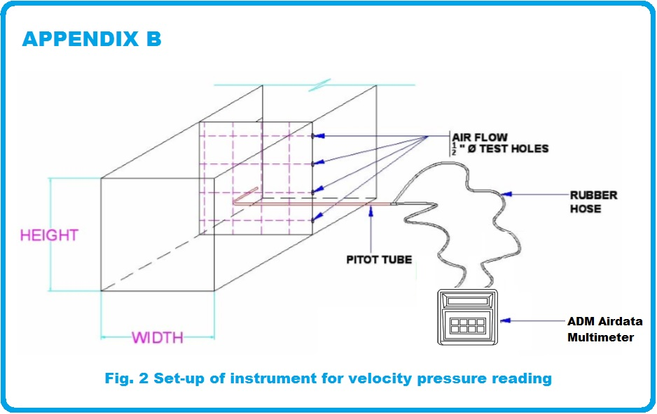
PROCEDURES FOR MEASURING TOTAL AIRFLOW BY PITOT TUBE
1. Measure inside duct dimension.
2. Drill 16mm Ø test holes for pitot traverse.
3. Set instrument for velocity pressure reading.

Slide 17
PORCEDURES FOR MEASURING TOTAL AIRFLOW BY PITOT TUBE
4. Check rubber hose connector for any leaks. Keep the manometer.
5. Make accurate measurement and take careful readings. Record data and fill up “traverse data” form. If the measured is within the tolerance proceed to branch balancing.
6. In cases where the main duct is not accessible or where are less number of diffusers, an alternate method is to sum up discharge air flows of all diffusers/outlets.

Slide 18
STEP 1 : MAIN BALANCING
1. Measure the total air flow with pitot tube and micro manometer in the main duct.
2. Compare measured air flow with design value. If measured value is within specified tolerance, the system is handling the desired absolute air flow in the main duct.
3. If measured air flow is not within specified tolerance, adjust main damper (VDM).

Slide 19
STEP 2 : BRANCH BALANCING
The second task is the per branch balancing. Refer to fig. 1 for illustration. Usually the most favored is branch A the nearest branch of the blower. and the far branch is the least favored is Branch C.

Slide 20
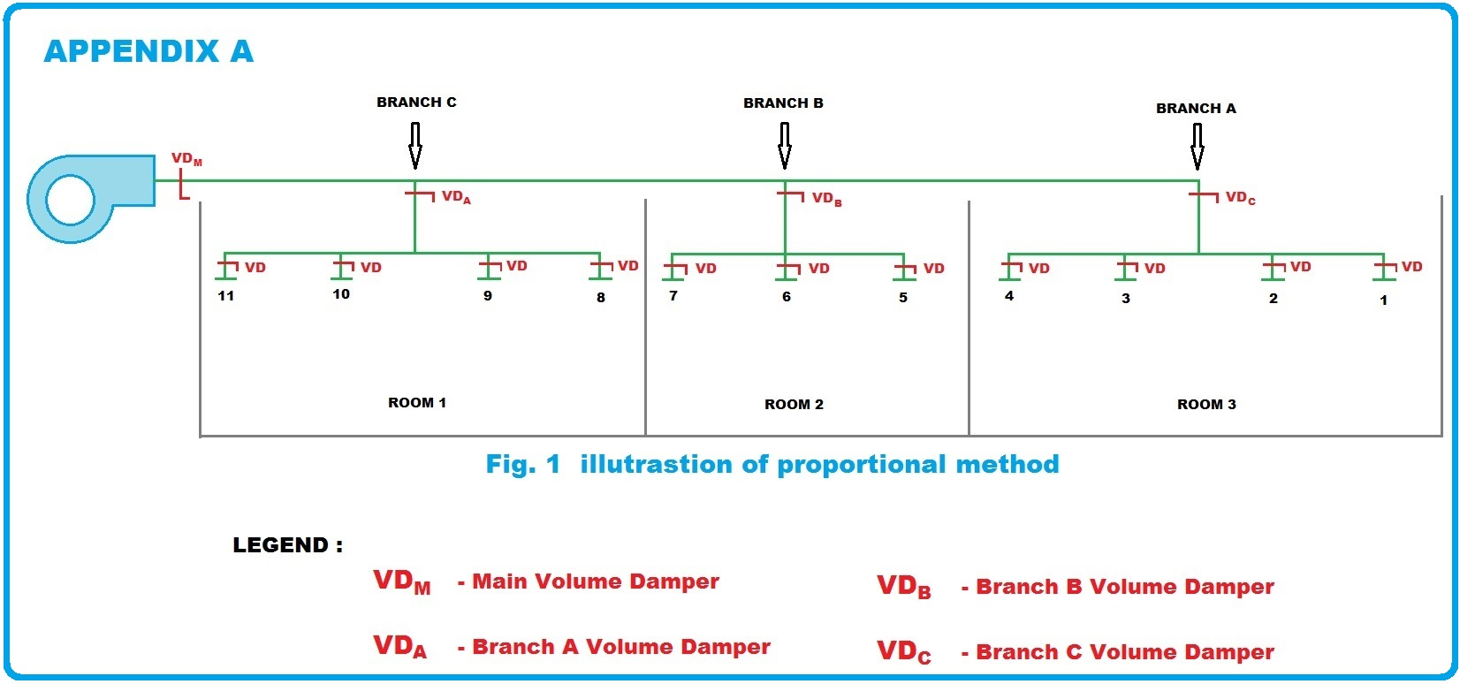
DIAGRAM OF BRANCH BALANCING

Slide 21
BRANCH BALANCING
1. Measure air flow for all branches outlet using direct reading hood (A, B & C) and calculate the percentage.
2. After calculating the percentage, refer to the least percentage. If the least favored is Branch C, keep in fully open position and the second least is Brach B, close the Branch B until the two branches are within the specified tolerance then proceed to the next branch.
3. The remaining terminals in branch A should be regulated in turn to specified, they are already balance.
4. Branches A and B are treated in the same way as Branch C.

Slide 22
STEP 3 : TERMINAL BALANCING
The third task is to balance the terminal to each other using direct reading hood. This is performed in a similar manner to the branch balancing procedure.

Slide 23
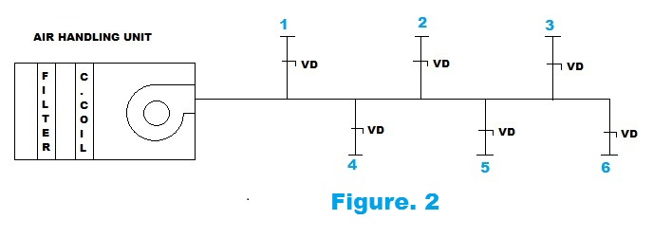
DIAGRAM OF TERMINAL BALANCING
OUTLET NO. | DESIGN (L/S) | ACTUAL (L/S) | PERCENTAGE %
3 | 200 | 150 | 75 %
6 | 200 | 160 | 80 %
2 | 200 | 200 | 100 %
5 | 200 | 235 | 118 %
4 | 200 | 240 | 120 %
1 | 200 | 250 | 125 %
TOTAL | 1200 | 1235 | 103 %

Slide 24
PERCENTAGE OF DESIGN AIRFLOW
Calculate the percentage (%) of design airflow for each outlet where the actual flow is 250 L/s and design is 200 L/s.
$$Percentage \left(\%\right)= \frac{Actual}{Design}$$
$Percentage \left(\%\right)= \frac{250 L/s}{200 L/s}$ x 100
$$=125 \%$$
The outlets are renumbered in their degree of percentage of design from the lowest to the highest as shown in the following example (based on Figure 2):

Slide 25
FIRST STEP
The damper for outlet number 3, the lowest percentage of design, is not adjusted. The damper for outlet number 6, the next lowest percentage of design, is adjusted until the airflow volume decreases to about 155 l/s. Outlet number 6 airflow volume should then come up to about 155 l/s. This should be verified by measurement, and these two outlets (3 and 6) should be in balance.

Slide 26
SECOND STEP
Outlet number 2, which is the next lowest percentage of design, is adjusted down to about 170 l/s . Outlets 3 and 6 should then come up to near 170 l/s and number 6 should be measured to verify this. Outlet numbers 3, 6 and 2 should all be basically in balance.

Slide 27
TEST FORMS
AHU-PFT- Equipment Checklist
AHU-Functional Performance Testing

Slide 28
TEST FORMS
AHU-PFT-Equipment Start-Up
Duct Traverse

Slide 29
TEST FORMS
Terminal Summary

Slide 30
FINAL TEST
After all balancing adjustments have been completed, final reading shall be taken. This will include a retest of amperage, voltage, static pressure, and rpm of the supply air fan. Final terminal readings will already have been taken. These results will be submitted and shall represent the exact condition of the system when the TAB technician completed the job. The system will be considered balanced when the airflow of each terminal is plus or minus 10% of the design airflow, unless there are condition beyond the TAB firm. All deficiencies shall be outline on the report. At this point, all the damper shall be marked for ease of resetting in case of tempering. Operation of automatic controls shall be checked and verified.

Slide 31
ACCEPTANCE CRITERIA
The systems will be considered balanced in accordance with NEBB Procedural Standards for Testing, Adjusting, and Balancing of Environmental Systems when the following conditions are satisfied:
1. All measured airflow quantities are within ± 10 percent of the design quantities unless there are reasons beyond the control of the NEBB Certified TAB Firm. Deficiencies shall be noted in The TAB report.
2. There is at least one direct path with fully open dampers from the fan to an air inlet or outlet. Additionally, if a system contains branch dampers, there will be at least one wide-open path downstream of every adjusted branch damper.

Slide 32
PERFORMANCE TEST
After aforementioned air system and water system balancing are completed, all temperatures shall be measured and recorded on the relevant Test Report Forms.
1. Chilled water temperature entering and leaving.
2. Ambient air temperature, dry bulb and wet bulb
3. Return air temperature, dry bulb and wet bulb.
4. Air temperature, dry bulb and wet bulb, entering and leaving cooling coils

Slide 33
FINAL TEST, INSPECTION AND ACCEPTANCE
All final tests and inspection required for acceptance of the aforementioned work shall be done and rechecked in the presence of the client’s representative at random selections of data recorded on the report.

Slide 34
INSTRUMENTATION TO BE USED
AIR SYTEM INSTRUMENT:
CLAMP METER
TACHOMETER
ELECTRONIC MICRO-MANOMETER W/ PITOT TUBE
FLOW MEASURING HOOD (DIRECT READING HOOD)
ANEMOMETER
THERMOHYGROMETER
SLING PSYCHROMETER
Including individual calibration certificates:

Slide 35
INSTRUMENT
AIR SIDE

Slide 36
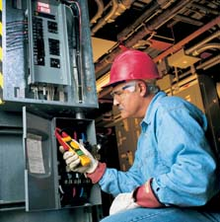
CLAMP METER
This clamp meter is ac current and voltage. Typical ac current measurements are taken on various branch circuits of an electrical distribution system. Determining how much current is flowing in various branch circuits is a fairly common task for the electrician.

Slide 37
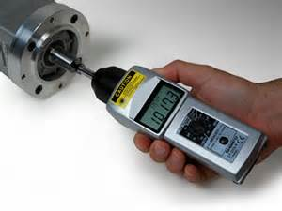
TACHOMETER
This tachometer is an shimpo instrument designed to measure the rotation speed of an object, such as a shaft in an motor that measures the revolutions per minute (RPMs) of the motor crankshaft.

Slide 38
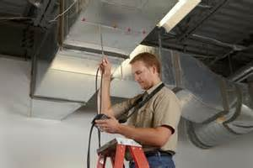
ADM (AIRDATA MANOMETER) W/ PITOT TUBE (ELECTRONIC MANOMETER)
This ADM from Shortridge Instruments is a versatile instrument used in Air Testing and Balancing that performs the following essential functions:
This meter measures air velocity when used with a Pitot tube, AirFoil probe, and automatically corrects for density variations due to local temperature and barometric pressure. Velocity ranges are 25-30,000 fpm using a pitot tube, 25-5,000 fpm using the AirFoil probe.
When used with the Series 8400 FlowHood System, this unit measures air flow and may compensate for density and backpressure effects, allowing direct air flow readings from 25-2500 cfm.

Slide 39
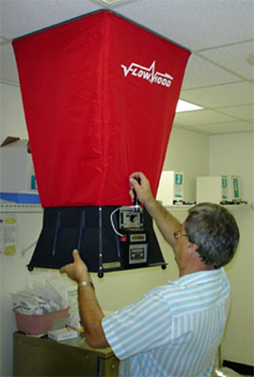
FLOW MEASURING HOOD (DIRECT READING)
This unit (Flow-Hood) measures air flow and may compensate for density and backpressure effects, allowing direct air flow readings in cubic feet per minute (cfm) and liters per second (L/s) corrected for local air density.

Slide 40
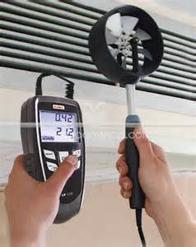
ANEMOMETER
This Anemometer is used for measuring the average air velocity at the face supply or return air grilles. The air velocity is displayed digitally and the reading is held as long as the button remains depressed.

Slide 41
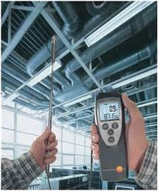
THERMOHYGROMETER
This Hygrometer is an instrument used for measuring the moisture content in the atmosphere. Humidity measurement instruments usually rely on measurements of some other quantity such as temperature.

