Slide 1
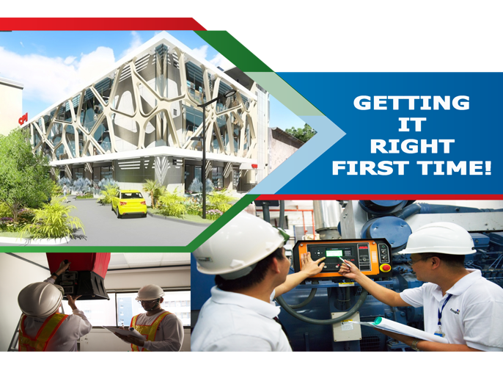



TESTING AND COMMISSIONING
DEPARTMENT
ORIENTATION
March 2023
LP03 Medical Plaza Bldg., 100 Amorsolo Street Legaspi Village Makati City Philippines 1229
www.forsspacglobal.com

Slide 2
Presentation outline
COMPANY BACKGROUND
COMPANY CAPABILITY
T&C DEPARTMENT TEAM ORGANIZATION
T&C DEPARTMENT STAFF
Testing and commissioning SERVICES
Project APPROACH
T&C PROJECTS
Notes:
Speech Notes - Slide 1
1. [Title 15] Title 15 Clip
Testing and Commissioning Management
2. [Slide] tv
testing and commissioning Management Services by Forspac ensure that the final building at handover follows the design intent resulting in a safe building that are pleasant to be in and are as energy efficient as possible.

Slide 3
Company Background
Forsspac is a leading construction industry Engineering and Architectural services provider. Our principal interests are in:
  Mechanical, Electrical, Plumbing and Fire Protection (MEPF) Design
  Testing & Commissioning Management
  3D Modeling (BIM)
  Architectural & Structural services
Forsspac is an innovative company with passion for driving forward the integration of all services from concept to handover. Working for developers, designers and contractors.

Slide 4
Company Background
Forsspac is composed of professional, experienced and forward-thinking people.
Founded in 1988 in Hong Kong
Founded in 1988 in Hong Kong
  2D CAD Production
  2D Coordinated Services Drawings
Based in Manila since 1996
Based in Manila since 1996
  2D Coordinated Services Drawings
  3D Coordinated Services Drawings
  Building Information Modeling
  Design Management
  Testing & Commissioning Management
  Outsourced CAD services

Slide 5
Company Background
Trading as Forsspac since 2010
  MEPF Design
  Spatial & Technical Coordination
  3D Coordinated Services Drawings
  Outsourced CAD Services
  Building Information Modeling
  Testing & Commissioning Management
  MEPF QA/QC Services

Slide 6
Company Background
Mission Statement
To provide high value, high integrity Building, Architectural and Infrastructure Services through the innovative use of knowledge and technology.
Vision Statement
That the Services we provide will continually improve the value, safety and sustainability of the buildings and infrastructure projects on which we work.

Slide 7

Company Background
Core Values

Slide 8
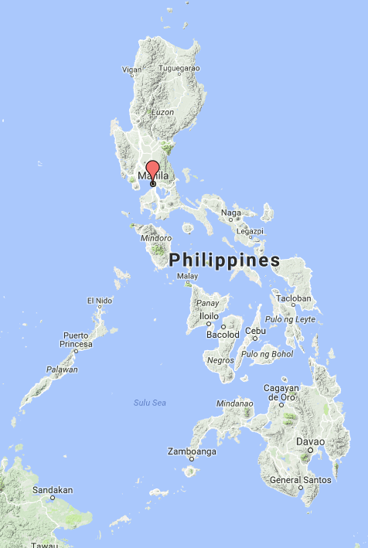
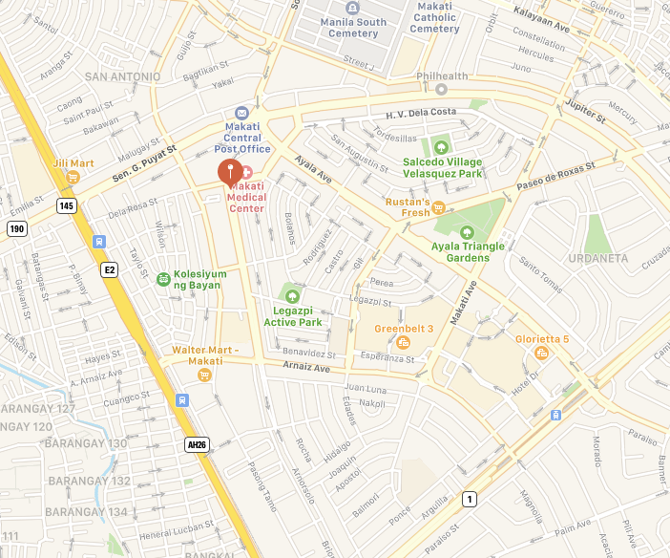
  Forssman opens its first Office in Manila
1996
  Forssman starts its Testing and Commissioning Division
2000
  Forssman established the Hong Kong satellite office to serve the first international market
2009
Forssman Pacific became Forsspac
2010
Forsspac re-entered the international market
2016
2020
Business Response to the pandemic
Leadership in Viral Load Reduction
In 2009, Forssman established the Hong Kong satellite office to serve the first international market
In 2000, Forssman starts its Testing and Commissioning Division
In 1996, Forssman opens its first Office in Manila
Notes:
Speech Notes - Slide 5
1. [Group 2] Group 2 Clip
In 1996, Forssman opens its first Office in Manila
2. [Group 3] Group 3 Clip
In 2000, Forssman starts its Testing and Commissioning Division
3. [Group 11] Group 11 Clip
In 2009, Forssman established the Hong Kong satellite office to serve the first international market
4. [Group 14] Group 14 Clip
In 2010, Forssman Pacific was renamed to Eight Pacific Corporation, trading as Forsspac ,to retain its former identity and to signify the transition to a full service MEPF company

Slide 9
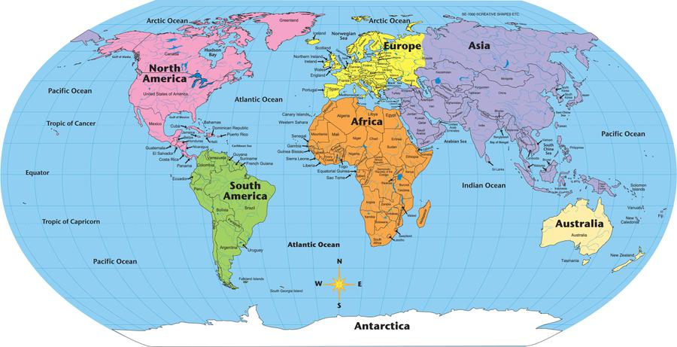

United Kingdom
United States
Philippines
Malaysia
New Zealand
Australia
  Since 2016 Forsspac has re-launched its international presence and has worked on projects in Australia, USA, UK and the Middle East
2016
During 2016 Forsspac launched its international sales program and has already established International Sales Agents in Australia, USA, UK, Malaysia, and New Zealand
Notes:
Speech Notes - Slide 6
1. [Picture 1] Picture 1 Clip
During 2016 Forsspac launched its international sales program and has already established International Sales Agents in Australia, USA, UK, Malaysia, and New Zealand

Slide 10
Company Capability
Comprehensive Engineering Services
Mechanical
Electrical
Hydraulics
Fire Protection
ELV Systems
Design
Design Services
QA/QC
Testing
and Commissioning
Technical Services
Condition Survey
Audit
TAB
Company Capability
BIM
Cloud Based Data Capture
Civil and Structural Engineering Services

Slide 11

Casino Resorts
Hotels
Hospitals
IT/BPO Offices
Manufacturing Plant
Industrial Parks
Airports
Rail
Office Towers
Residential Towers
Ports
Oil and Gas

Slide 12
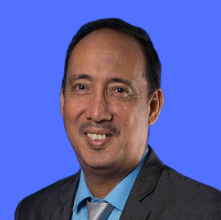
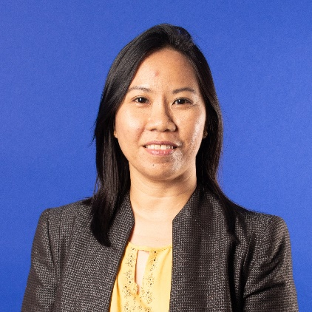
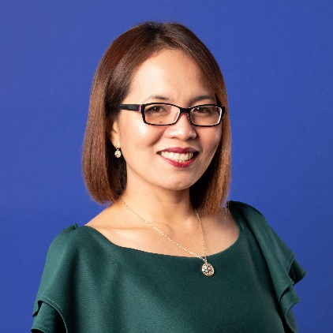
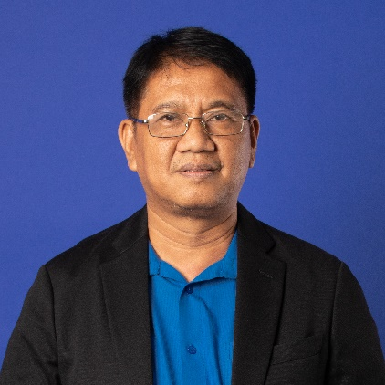
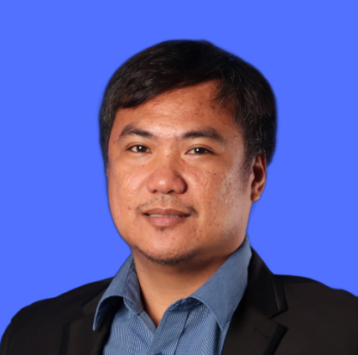
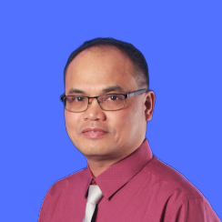
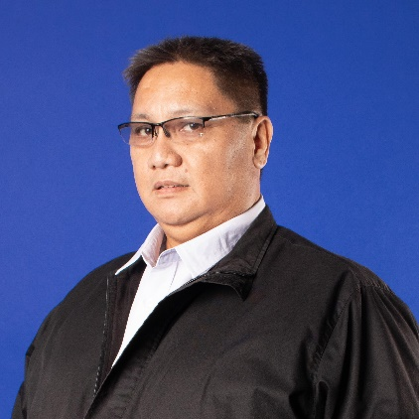
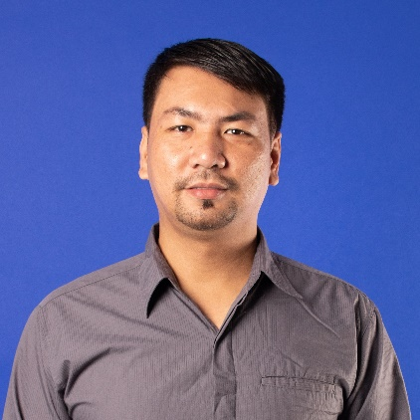
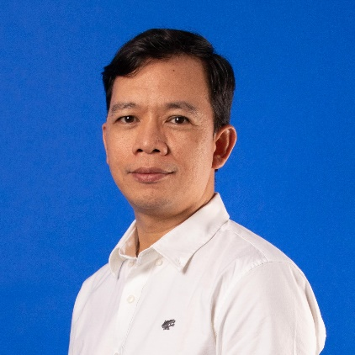
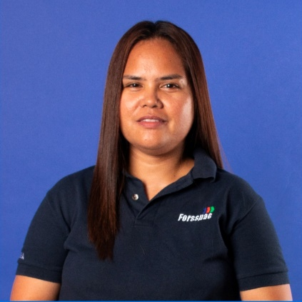
T&C Department Team Organization
ROSSWALDO DIMAGUILA
DEPARTMENT MANAGER
SHEILA CIRUELA
LEED / T&C PROJECT
MANAGER
FILIPINAS SAYNO
ADMIN T&C OPERATION
ALBERTO TORRES
T&C PROJECT MANAGER
GILBERT RICO
T&C PROJECT MANAGER
MARCELO FERNANDO
T&C PROJECT MANAGER
SANTAYANA DE VERA
T&C PROJECT MANAGER
BRYAN TENORIO
T&C PROJECT MANAGER
BONIFACIO PIZANA III
SR. MECHANICAL ENGINEER
SANDRA FUNTANAR
SR. ISTO ENGINEER
Notes:
Speech Notes - Slide 9
1. [Slide] t
The testing and commissioning team
2. [Picture 5] Picture 5 Clip
the Testing and commissioning department is headed by the T & C Manager , Mister Roswaldo Dimagila
3. [Picture 16] Picture 16 Clip
Project Managers, Senior engineers,leads each project together with the electrical and mechanical engineers I S T O Engineers and Technicians .

Slide 13
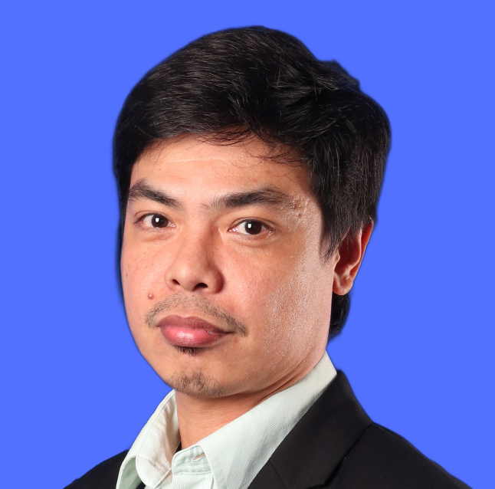
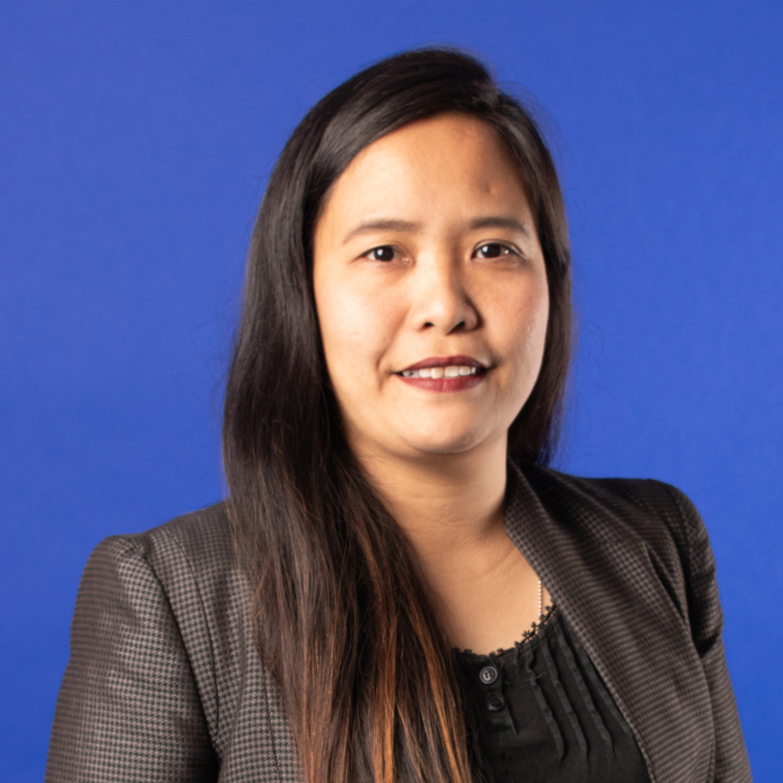
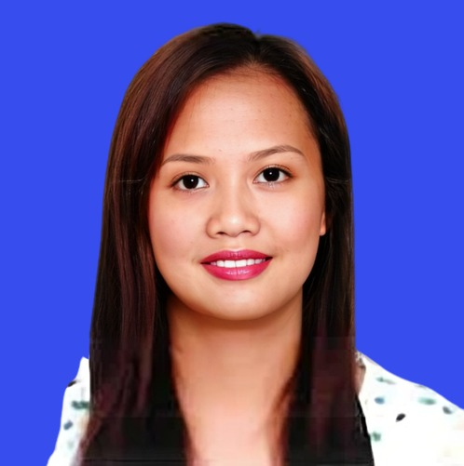
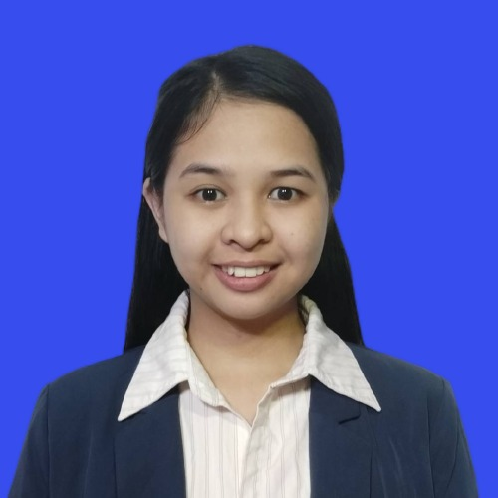
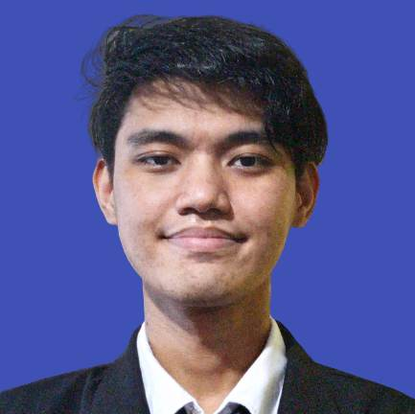
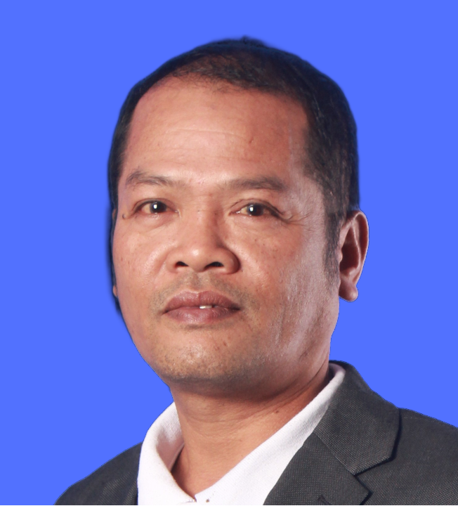
T&C Department Staff
ISTO Engineers
ARNEL QUIROZ
ISTO ENGINEER
VANESSA MAMANGON
ISTO ENGINEER
SHARRIE MAE PASCUA
ISTO ENGINEER
ANNIE CABATAY
JR. ISTO ENGINEER
ALLAN GRANT ARTURO
ISTO ENGR. /
JR. T&C MECHANICAL ENGR.
ROLANDO PIZARRA
DOCUMENT CONTROLLER

Slide 14
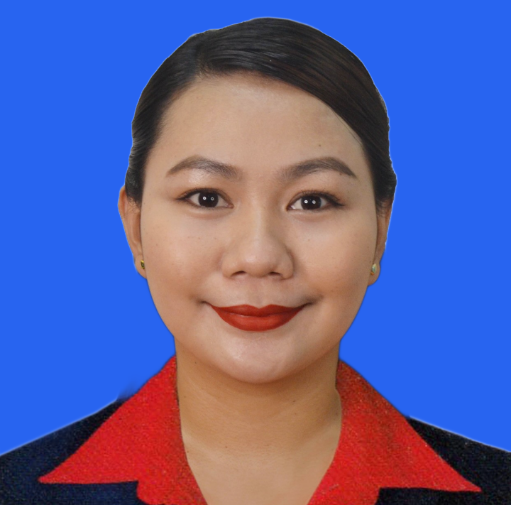
T&C Department Staff
T&C Sales
LY CATABAY
T&C SALES PERSON

Slide 15
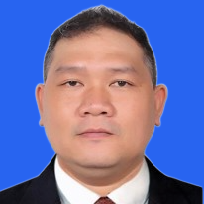
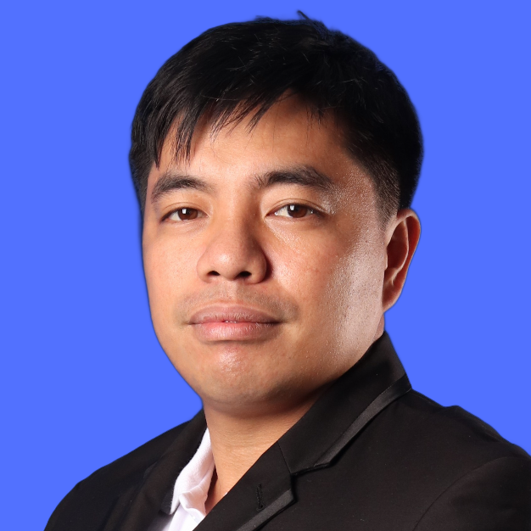
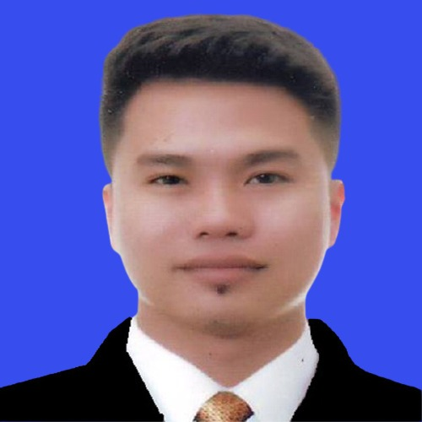
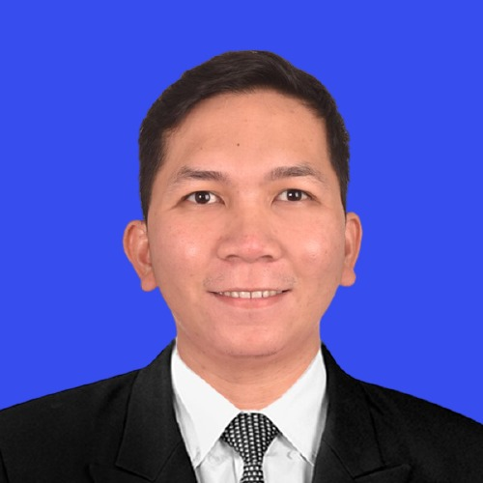
T&C Department Staff
T&C Mechanical Engineers
DIOSDADO NINO CUDIA
T&C MECHANICAL ENGINEER
JULIAN MABUDIANG
T&C MECHANICAL ENGINEER
VINCENT LEE VILLA
T&C MECHANICAL ENGINEER
JHOMARIE ACOBA
T&C MECHANICAL ENGINEER

Slide 16
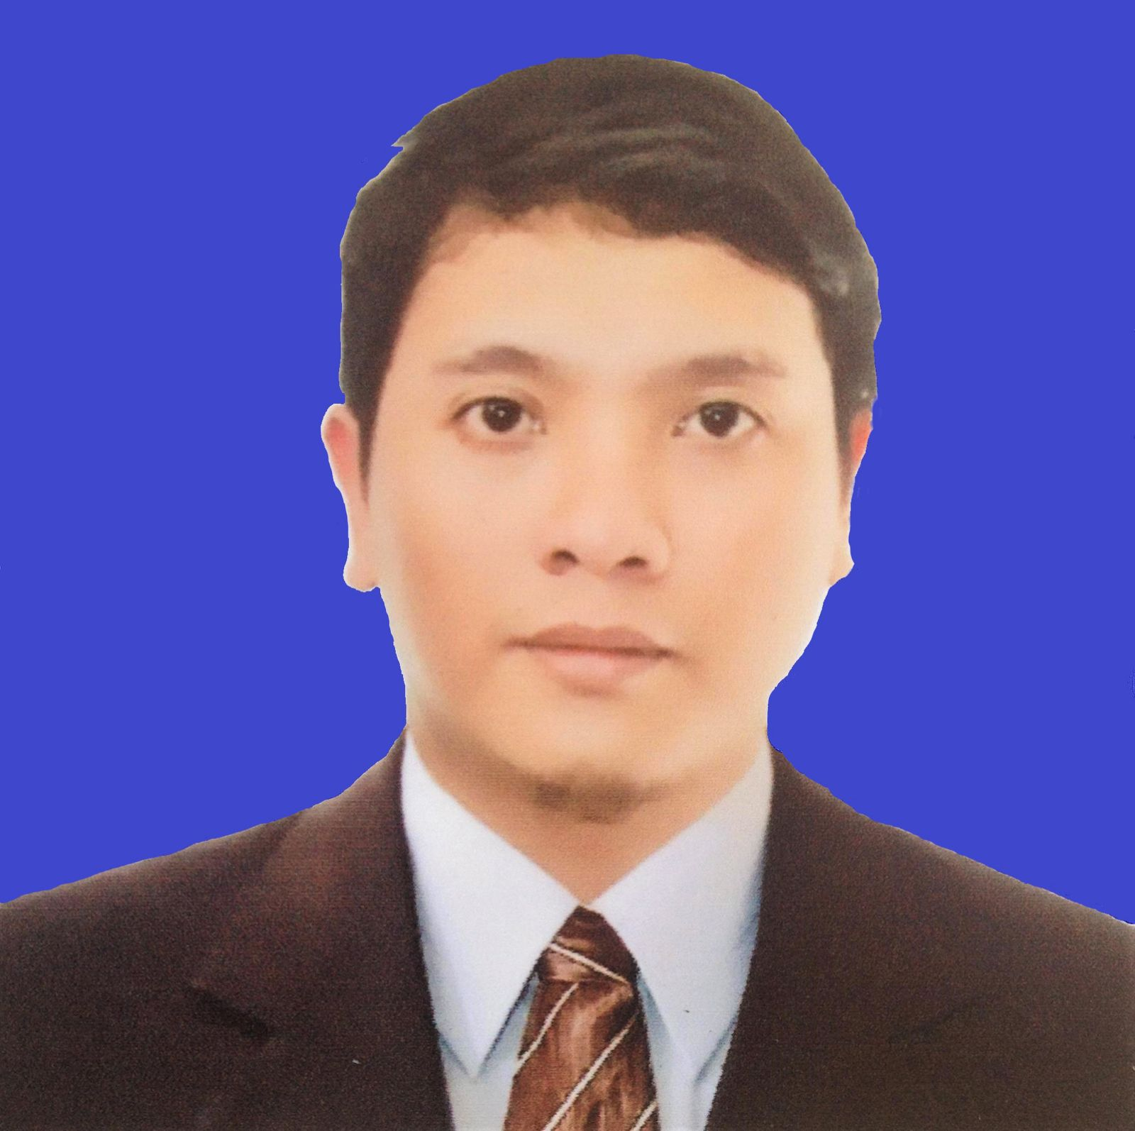
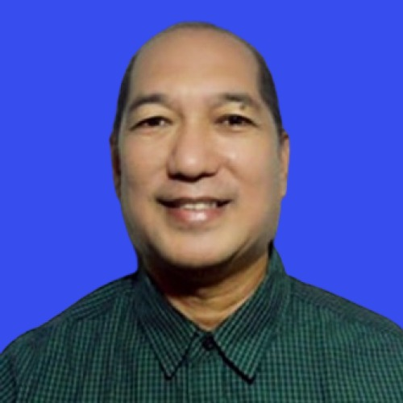
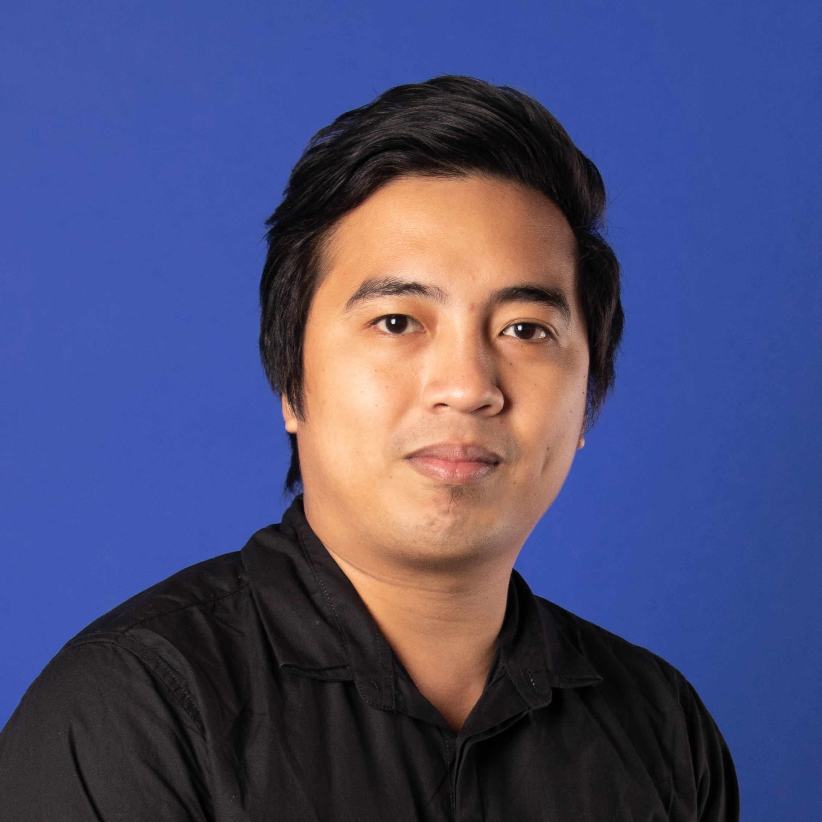
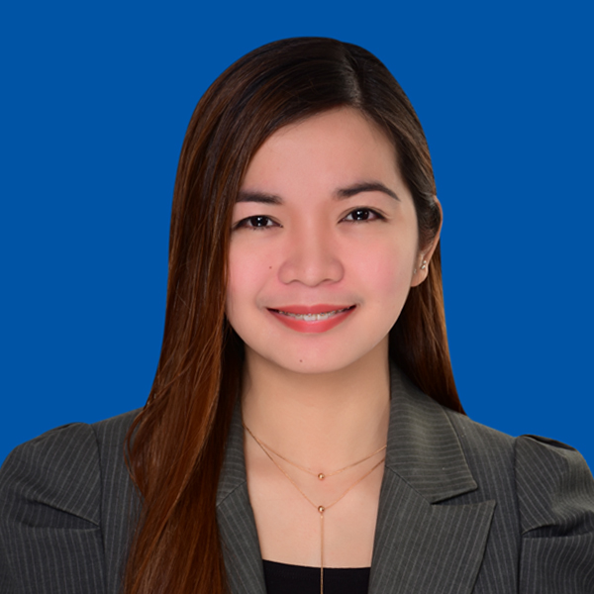
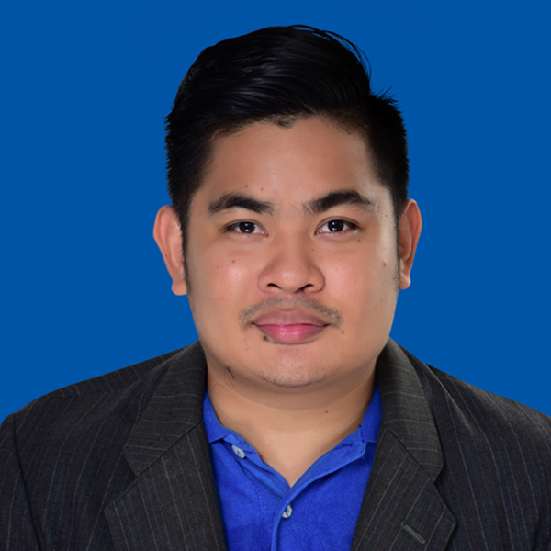
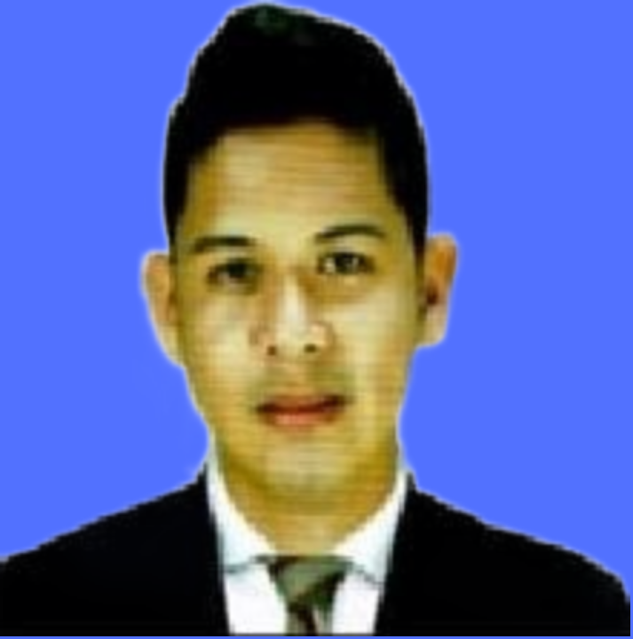
T&C Department Staff
T&C Electrical Engineers
BENJAMIN NOCETE JR
T&C ELECTRICAL ENGINEER.
RENATO MAGLENTE
T&C ELECTRICAL ENGINEER.
JOSEPH IGNACO
T&C ELECTRICAL ENGINEER.
NIKKO ZAMORA
T&C ELECTRICAL ENGINEER
REBERLYN GUIRUELA
JR. T&C ELECTRICAL ENGR.
RENMARK DIOQUINO
JR. T&C ELECTRICAL ENGR.

Slide 17
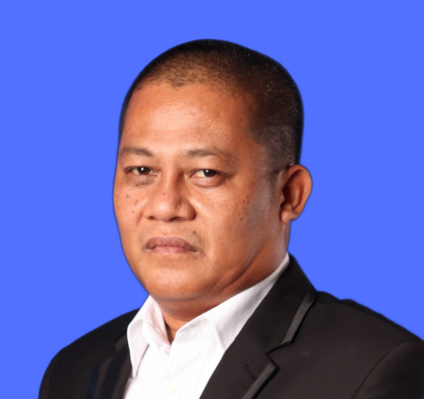
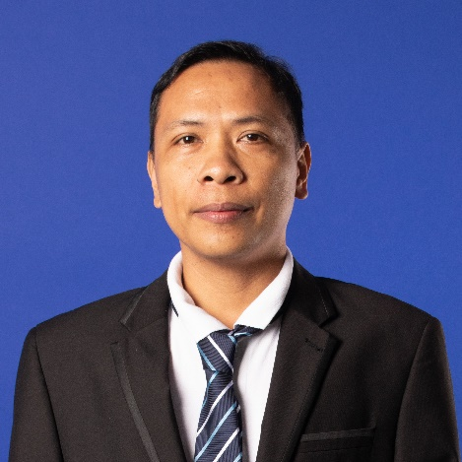
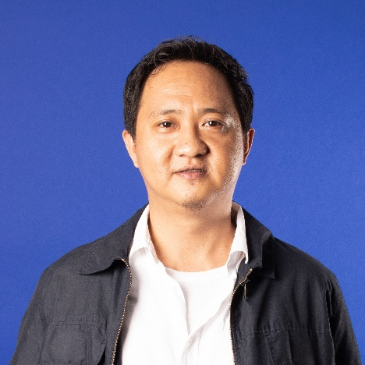
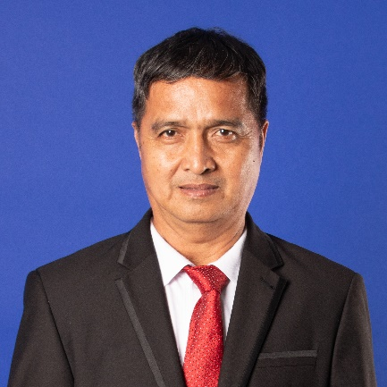
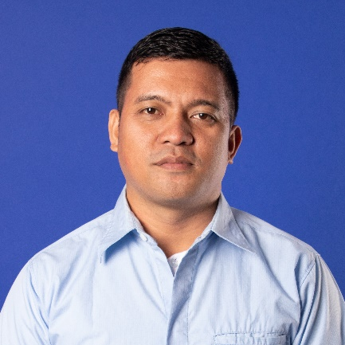
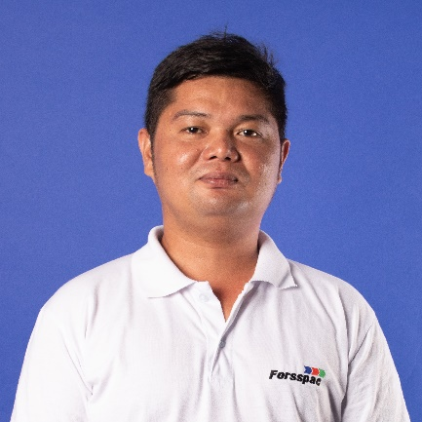
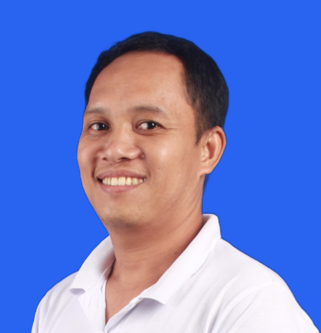
T&C Department Staff
T&C Technicians
ROMAR DIMDAM
TAB SUPERVISOR
PIO REYES JR.
TAB SUPERVISOR
LEONARDO MOLINA
SUPERVISOR
LOU LOUSITO CAASI
TAB TECH
JENER GUETA
TAB TECH
MONCHITO LABAGUIS
TAB TECH
MARIEL PERALTA
TAB TECH

Slide 18
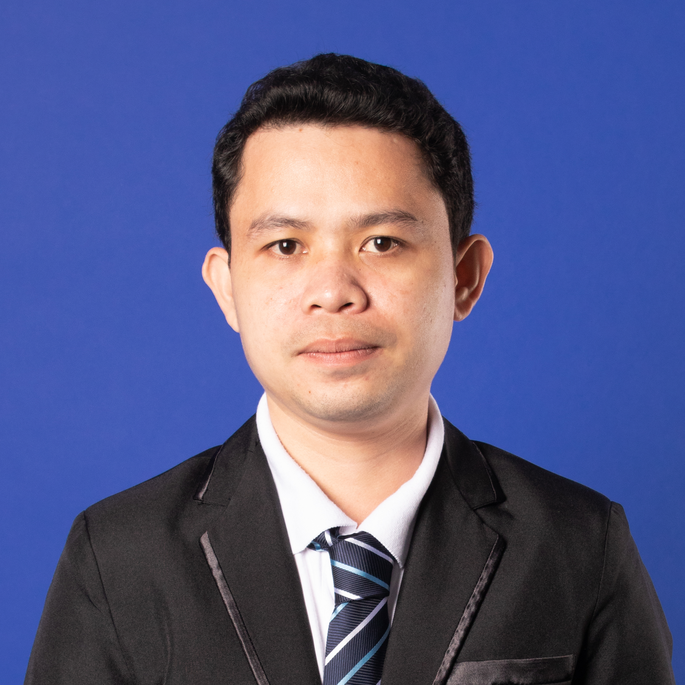
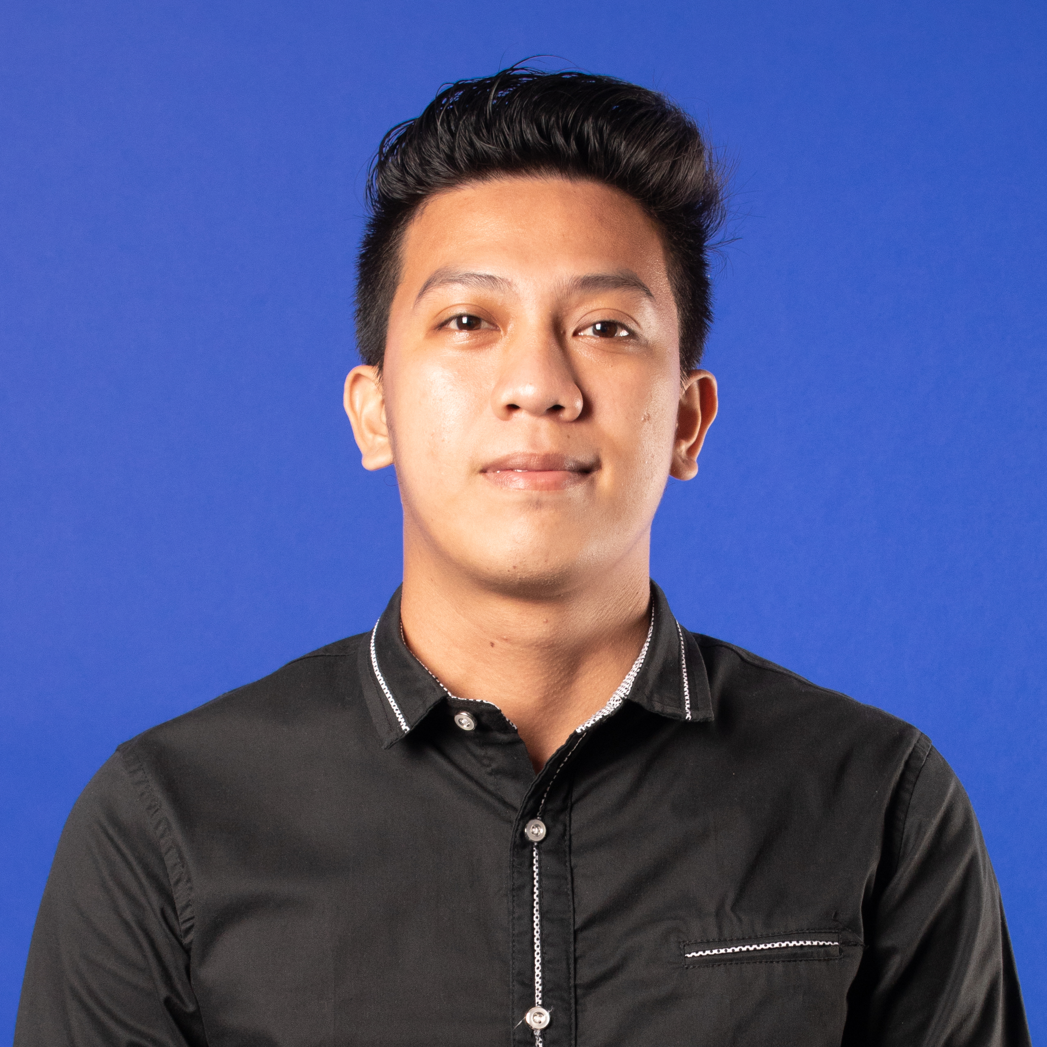
T&C Department Staff
T&C Technicians
MANUEL ATIENZA JR
ELECTRICAL SUPERVISOR
JERRY JUNE LORA
ELECTRICAL TECHNICIAN

Slide 19
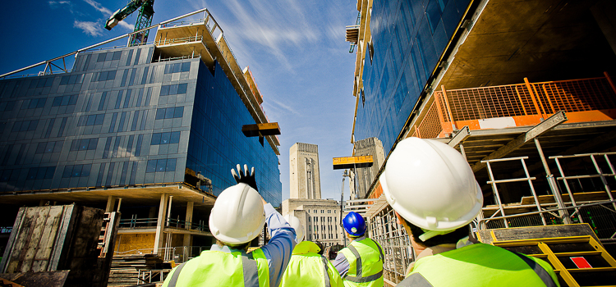
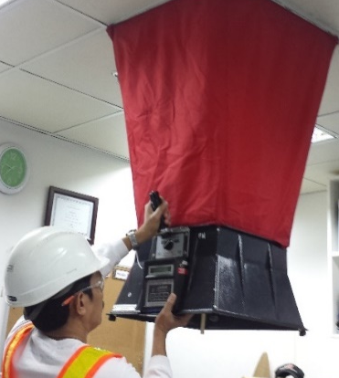
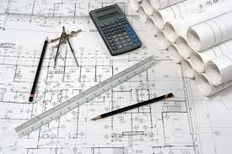
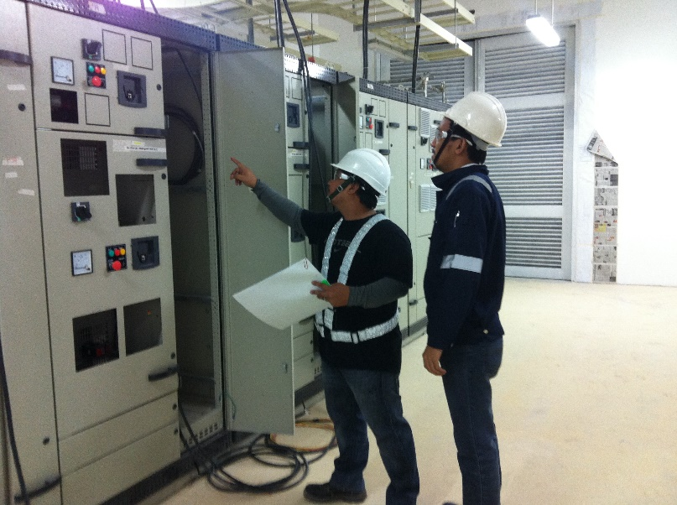
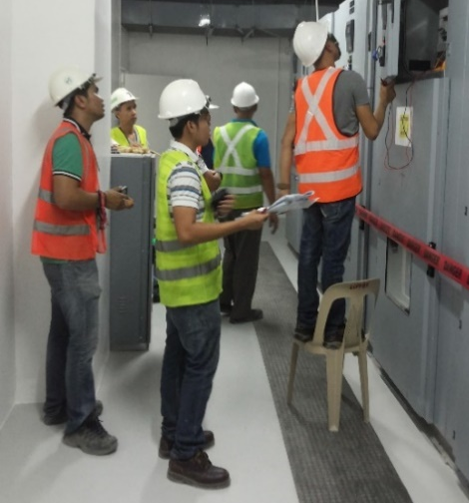
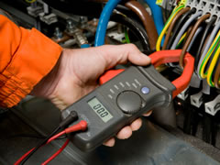
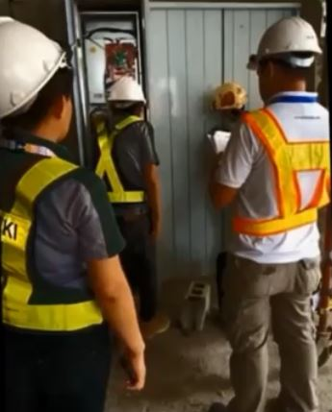
Testing and Commissioning Services
20+ Years of Leadership
in Testing and Commissioning
in the Philippines
Notes:
Speech Notes - Slide 1
1. [Content Placeholder 52] Content Placeholder 52 Clip
Testing and Commissioning Management
2. [TextBox 312] TextBox 312 Clip
the following are the Testing and Commissioning Work Scope
3. [Content Placeholder 522] Content Placeholder 522 Clip
Commissionability Study
4. [Content Placeholder 55] Content Placeholder 55 Clip
Quality Assurance and Quality Control Services
5. [Content Placeholder 5] Content Placeholder 5 Clip
LEED Commissioning Authority
6. [Content Placeholder 53] Content Placeholder 53 Clip
BER DE Commissioning Authority
7. [Content Placeholder 54] Content Placeholder 54 Clip
M E P F System Audit
8. [Content Placeholder 56] Content Placeholder 56 Clip
Testing, Adjusting and Balancing

Slide 20
Commissioning Skills and Capability
Our Testing and Commissioning Management and Technical Services cover all aspects of building commissioning, auditing and facility management:
Testing and Commissioning | Technical Services
T&C Management | Condition Auditing
LEED Commissioning Authority (CxA) | Power Quality Analysis
BERDE Commissioning | Thermographic Studies
Testing, Adjusting and Balancing | Indoor Air Quality (IAQ) Analysis
Re-commissioning | Fire and Life Safety Auditing
Retro-commissioning Cause and Effect Testing Digital Facility Management ready data platform | Equipment and Systems Failure Diagnosis Covid-19 MVAC Safety Auditing Covid-19 MVAC Systems Retrofit Services As-Built Surveys and Drawing Production
Notes:
Speech Notes - Slide 9
1. [Slide] t
The testing and commissioning team
2. [Picture 5] Picture 5 Clip
the Testing and commissioning department is headed by the T & C Manager , Mister Roswaldo Dimagila
3. [Picture 16] Picture 16 Clip
Project Managers, Senior engineers,leads each project together with the electrical and mechanical engineers I S T O Engineers and Technicians .

Slide 21
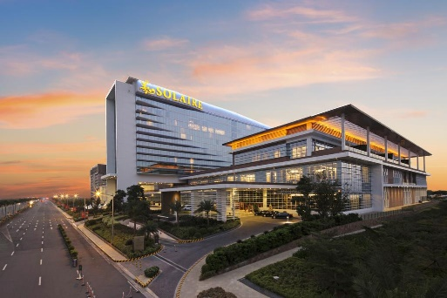
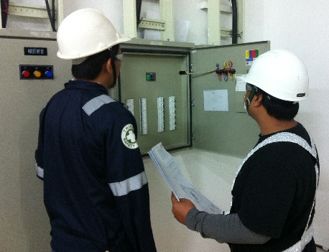


Commissionability Study
Forsspac believes that the Commissionability study is the cornerstone for any good Testing & Commissioning project.
Testing and Commissioning Management
Doing it right first time requires skill, experience and knowledge, all of which Forsspac have in-house.
LEED CxA
Working towards LEED certification for new buildings starts with design oversight, through competent construction to T&C Management.
BERDE CxA
Establish a project-specific system that would effectively undertake the commissioning of the development’s service systems.
Notes:
Speech Notes - Slide 2
1. [Group 1] Group 1 Clip
Commissionability study
Forsspac believes that the Commissionability study is the cornerstone for any good Testing & Commissioning project. They are conducted by our qualified and experienced staff using the available design information and owners requirements.
2. [Group 2] Group 2 Clip
Testing & Commissioning Management
Doing it right first time requires skill, experience and knowledge, all of which Forspac have in house
Since Forsspac launch its Testing & Commissioning department fifteen years ago, Forsspac have continually invested in best-practice systems of work that adhere to or surpass international standards.
3. [Group 4] Group 4 Clip
LEED Commissioning Agent
Working towards LEED certification for new buildings starts with design oversight, through competent construction to testing and commissioning management.Forsspac’s commissioning philosophy and management services embrace the whole-building systems approach established by ASHRAE and N E B B which fully support the principles of LEED.
4. [Group 5] Group 5 Clip
BER DE commissioning agent
Forsspac established a project-specific system that would effectively undertake the commissioning of the development’s service systems.

Slide 22
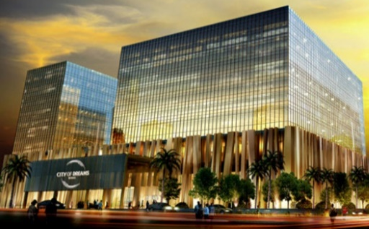
System Audit
M
P
F
E
MEPF Systems Audit
Forsspac’s team are highly experienced in the audit of building systems working quickly and efficiently through the building.
QA/QC Services
A building or development of the highest quality can only be achieved when a high quality design is realised through the construction process.
Testing, Adjusting and Balancing (TAB)
Forsspac’s professional TAB services result in comfortable, low noise and odour free environments at reduced operating costs.
Notes:
Speech Notes - Slide 3
1. [Group 2] Group 2 Clip
M E P F Systems Audit
Forsspac’s team are highly experienced in the audit of building systems working quickly and efficiently through the building.
2. [Group 3] Group 3 Clip
Quality Assurance and Quality Control Services
A building or development of the highest quality can only be achieved when a high quality design is realised through the construction process.
3. [Group 4] Group 4 Clip
Testing, Adjusting and Balancing or TAB
Forsspac’s professional TAB services result in comfortable, low noise and odour free environments at reduced operating costs.

Slide 23
PROJECT APPROACH
Testing and Commissioning Management
Commissionability Study
Commissioning Plan
Documentation Process
Construction Testing
Pre Functional Testing
Functional Performance Testing
Acceptance Testing
Scheduling
Training and
Seminars
Method
Statements
Operation and
Maintenance
Manuals
Quality Standards
Calistodata Online Data Capture
Witnessing
Notes:
Speech Notes - Slide 2
1. [TextBox 13] TextBox 13 Clip
Testing and Commissioning Process
2. [Freeform 2] Freeform 2 Clip
Pre-commissioning or Pre-functional Testing
3. [Freeform 5] Freeform 5 Clip
Pre-commissioning is One of the construction activity that involves the verification of functional operability of elements within the system to achieve a state of readiness for the Commissioning and Start-up operation.
4. [Freeform 6] Freeform 6 Clip
Commissioning or Functional Performance Testing
5. [Freeform 8] Freeform 8 Clip
Commissioning
is a Process of verifying that all systems and components of a building are designed, installed, tested, operated, and maintained according to the operational requirements of the owner.
6. [Freeform 9] Freeform 9 Clip
Test Results Acceptance
7. [Freeform 11] Freeform 11 Clip
Assessment of the results to see if they are consistent with the equipment specification and the projected operating point of the system. Any discrepancies are investigated. If there are no major issues then the Test Pack will be signed off, this may be with or without comments.

Slide 24
Testing, Adjusting and Balancing
HVAC TAB
Hydronic System
Chiller System
Pumping System
Air Handling System
Cooling Tower System
d
c
a
w
m
Notes:
Speech Notes - Slide 6
1. [Title 1] Title 1 Clip
LEED C x A Responsibilities
2. [Slide] d
design stage
3. [Slide] c
construction phase
4. [Slide] a
acceptance phase
5. [Slide] w
warranty phase
6. [Slide] m
measurement and verification

Slide 25
LEED Commissioning Authority
OPR, BOD, design drawings
LEED Commissioning
Construction Phase
Acceptance Phase
Warranty Phase
Design Phase
Monitoring Based Cx
Commissioning Spec and Plan
Implement / Monitor building consumption
thru Building Automation System
Current Facility Requirement
Submittals
Ongoing Commissioning Plan
Systems Manual
Perform equipment performance testing
Commissioning Report
T&C Witnessing
Training
Manuals
Notes:
Speech Notes - Slide 6
1. [Title 1] Title 1 Clip
LEED C x A Responsibilities
2. [Slide] d
design stage
3. [Slide] c
construction phase
4. [Slide] a
acceptance phase
5. [Slide] w
warranty phase
6. [Slide] m
measurement and verification

Slide 26
QA/QC
Materials Validation
QA/QC
Installation
Testing
Documentation
Materials
Punchlist Close Out
Work Samples
As-Built Validation
Progress Tracking and Reporting
Test Documentation
Installation inspection
Witnessing
NCN’s
Instrumentation Validation
Technical Skills Validation
Notes:
Speech Notes - Slide 6
1. [Title 1] Title 1 Clip
LEED C x A Responsibilities
2. [Slide] d
design stage
3. [Slide] c
construction phase
4. [Slide] a
acceptance phase
5. [Slide] w
warranty phase
6. [Slide] m
measurement and verification

Slide 27
BERDE Commissioning Authority
Drawing review
BERDE Commissioning
Construction Phase
Acceptance Phase
Training Requirement
Design Phase
Commissioning Spec and Plan
Training
Submittals Verification
Manuals
T&C Witnessing
Notes:
Speech Notes - Slide 6
1. [Title 1] Title 1 Clip
LEED C x A Responsibilities
2. [Slide] d
design stage
3. [Slide] c
construction phase
4. [Slide] a
acceptance phase
5. [Slide] w
warranty phase
6. [Slide] m
measurement and verification

Slide 28
T&C Completed Projects
Project Name | Location | Certification applied | Scope of Service | Year completed
MPTS Hive | Imus Cavite | Silver | Fundamental | 2022
One Paseo – Megaworld | Pasig City | Gold | Enhanced | 2022
ATG Diamond – Ayala Land | Makati City | Gold | Enhanced | 2021
MTRO MDI Warehouse | Sta Rosa Laguna | Gold | Enhanced | 2021
MPTS Headquarters - Hub | Imus Cavite | Silver | Enhanced | 2021
Shell Manila New Office | Taguig City | Silver | Enhanced | 2021
JEG Tower | Cebu City | Gold | Fundamental | 2021
Mpire Center – Monolith | Quezon City | Gold | Enhanced | 2021
M Moser | Makati Ave. Makati City | Gold | Enhanced | 2021
Studio 7 | Edsa, Diliman Quezon City | Silver | Fundamental | 2021
Filinvest Axis Towers 4 – Filinvest | Alabang, Muntilupa City | Gold | Fundamental | 2021
Filinvest Axis Towers 3 – Filinvest | Alabang, Muntilupa City | Gold | Fundamental | 2021

Slide 29
T&C Completed Projects
Project Name | Location | Certification applied | Scope of Service | Year completed
BPLAC Renovation Office | Makati Ave. Makati City | Platinum (V4) | Enhanced | 2020
Parkway Corporate Center – Filinvest | Alabang, Muntilupa City | Silver (V4) | Fundamental | 2020
Frabelle de Salcedo | Salcedo, Makati City | Gold | Enhanced | 2020
Parkway Corporate Center – Filinvest | Alabang | Silver (V4) | Fundamental | 2019
Cyberzone Bay City Phase 3 – Filinvest | Pasay City | Silver | Fundamental | 2019
One Griffinstone | Alabang, Muntinlupa City | Silver | Fundamental | 2019
BDO Corporate Center | Ortigas | Gold | Enhanced | 2019
Uptown project Tower 1- Megaworld | BGC, Taguig City | Silver | Enhanced | 2019
Uptown project Tower 2- Megaworld | BGC, Taguig City | Silver | Enhanced | 2019
Filinvest Axis Towers 1 & 2 - Filinvest | Alabang, Muntinlupa City | Gold | Fundamental | 2019
Cyberzone Bay City Phase 1 – Filinvest | Pasay City | Silver | Fundamental | 2019
Menarco Tower | BGC, Taguig City | Gold | Enhanced | 2018
Diversified Technology Solution Inc. LEED CI | One Paseo, Makati City | Platinum | Enhanced | 2018

Slide 30
T&C Completed Projects
Project Name | Location | Certification applied | Scope of Service | Year completed
Proscenium Phase 1 | Rockwell, Makati City | N/A | T&C Management | 2020
The Greenfield Tower | Mandaluyong City | N/A | T&C Management | 2019
Zitan Tower | Mandaluyong City | N/A | T&C Management | 2019
Okada Manila | Paranaque, Pasay City | N/A | T&C Management | 2018
Marriot Hotel | Paranaque, Pasay City | N/A | T&C Management | 2018
FEU Alabang | Alabang, Muntinlupa City | N/A | T&C Management | 2018
RiverGreen Tower – South and North | Sta. Ana, Manila | N/A | T&C Management | 2018
Unilever K2C | General Trias, Cavite | Silver | Fundamental | 2018
Exxa and Zeta Tower – Robinsons Land | Bagumbayan Pasig City | Silver | Fundamental | 2018
Cyberzone Bay City Phase 2 – Filinvest | Pasay City | Silver | Fundamental | 2018
HSBC Alabang Level 2 to Level 6 LEED CI | Alabang, Muntinlupa City | Gold | Enhanced | 2018

Slide 31
T&C Completed Projects
Project Name | Location | Certification applied | Scope of Service | Year completed
Citadines | Ortigas, Pasig City | N/A | T&C Management | 2017
Twin Oaks Phase 2 | Mandaluyong City | N/A | T&C Management | 2017
Vector Three - Filinvest | Alabang, Muntinlupa City | Gold | Fundamental | 2017
Novotel Hotel | Cubao, Quezon City | N/A | T&C Management | 2016
Net Park Building | Fort Bonifacio Global, Taguig City | N/A | T&C Management | 2016
SM Aura | BGC, Taguig City | Gold | Enhanced | 2015
Zuellig Building Executive Office LEED CI | Makati City | Platinum | Enhanced | 2015
City of Dream, Manila | Paranaque, Pasay City | N/A | T&C Management | 2015
Solaire Phase 1 and Phase 1A | Paranaque, Pasay City | N/A | T&C Management | 2015
St Lukes Medical Center | Fort Bonifacio Global, Taguig City | N/A | T&C Management | 2015
Zuellig Building LEED CS | Makati City | Platinum | Enhanced | 2014

Slide 32
T&C Completed Projects
Project Name | Location | Certification applied | Scope of Service | Year completed
Twin Oaks Tower 1 | Shaw Boulevard, Mandaluyong City | N/A | T&C Management | 2014
HSBC Building | Alabang, Muntinlupa City | N/A | T&C Management | 2014
The Medical City - Clark | Clark Freeport Zone, Pampanga | N/A | T&C Management | 2013
The New Medical City | Ortigas Extension, Pasig City | N/A | T&C Management | 2013
Aegis People Support Cebu Phase 1 LEED NC | IT Park, Cebu City | Silver | Enhanced | 2012
One Rockwell | Rockwell Drive, Makati City | N/A | T&C Management | 2011
Joya Loft and Tower | Rockwell, Makati City | N/A | T&C Management | 2011
Aegis People Support Cebu Phase 2 LEED NC | IT Park, Cebu City | Gold | Enhanced | 2010
Pilipinas Shell Petroleum Corp. Admin. Bldg. LEED NC | Batangas City | Silver | Fundamental | 2010
Radisson Hotel , Blue | Cebu City | N/A | T&C Management | 2010

Slide 33


T&C Ongoing Projects
PARQAL Mixed-Used
8912 Aseana Ave.
Client: Aseana Holding Inc.
Location: Aseana Ave, Aseana City, Parañaque, 1701 Metro Manila
Services provided: BERDE Commissioning Authority (CxA)
Client: Aseana Holding Inc.
Location: Aseana Ave, Aseana City, Parañaque, 1701 Metro Manila
Services provided: LEED Commissioning Authority (CxA)

Slide 34
T&C Ongoing Projects
Admiral Hotel, Manila
Activa, Cubao
Client: Anchorland
Location: Ermita, Manila
Services provided: Testing and Commissioning Management
Client: Filinvest Land, Inc.
Location: Cubao, Quezon City
Services Provided: LEED Commissioning Authority (CxA)

Slide 35

T&C Ongoing Projects
Ciudad De Cebu, IT Park
Tryne Tower 1
Client: Filinvest Land, Inc.
Location: IT Park, Cebu
Services Provided: LEED Commissioning Authority (CxA)
Client: Ayala Land Incorporated
Location: Arca South, BGC, Taguig City
Services Provided: LEED Commissioning Authority (CxA) – V4

Slide 36


T&C Ongoing Projects
110 Benavidez
One Vertis Plaza
Client: Legaspi Village Land Properties Inc.
Location: 110 Benavidez Street, Legaspi Village, Makati
Services Provided: Testing and Commissioning Management
Client: Ayala Land Premier
Location: Vertis North, Quezon City
Services provided: LEED Commissioning Authority (CxA)

Slide 37


T&C Ongoing Projects
Operation District Building
North – South Commuter Railways - Depot
Client: MPCala Holdings Incorporated
Location: General Trias Cavite
Services Provided: LEED Commissioning Authority (CxA) – V4
Client: Taisei – DMCI Joint Venture.
Location: Valenzuela City
Services provided: Testing and Commissioning Management

Slide 38

T&C Ongoing Projects
SM Baguio Renovation and Expansion Project
Instant Manila – Phase 4
Client: SM Prime Holdings, Inc.Location: Clark Angeles, Luneta Hill Drive, 2600, Upper Session Rd, Baguio, Benguet Philippines
Services provided: LEED Commissioning Authority (CxA)
Client: Instant Manila (AMEX)
Location: B.G.C. Corporate Center 2 Building, 5th Avenue corner 30th Street Bonifacio Global City, Taguig
Services provided: Integrated Testing and Electrical System Audit

Slide 39


